Slide 1
Credit Card Fraud Detection EDA Case Study
Kalpit Kishore

Slide 2
Business Understanding & Overview
Credit card fraud poses a severe threat to payment processors, issuing banks, and consumers. Unauthorized transactions result in direct financial liabilities through chargebacks, operational overhead in managing disputes, and diminished customer trust. The primary operational objective is to detect unauthorized transactions in real time or near-real time to block fraudulent charges before settlement without disrupting genuine transactions.

Slide 3
Understanding the data

Slide 4
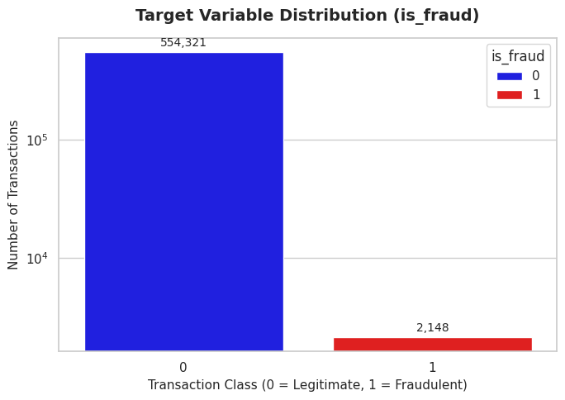
Target Variable
Findings
Data is highly imbalanced; ratio is almost 275:1.
Most of the credit card holders are legitimate.
We need to analyse the data with other feature while taking the target values separately to get some insights.

Slide 5
Missing Data
Findings
Out of 556,469 total rows, 7 columns contain missing values, totaling 5237 missing entries across the dataset. Overall missingness is low (=<0.22% per column)
For features with less missing values – can use regression to predict the missing values of fill with the mean of the values present, depending on the feature.
For features with very high number of missing values – it is better to drop those columns as they give very less insights on analysis.
As there’s no thumb rule on what criteria do we delete the columns with high number of missing values, we have done a small analysis and have taken decisions, Analysis to be continued in next slides…..

Slide 6
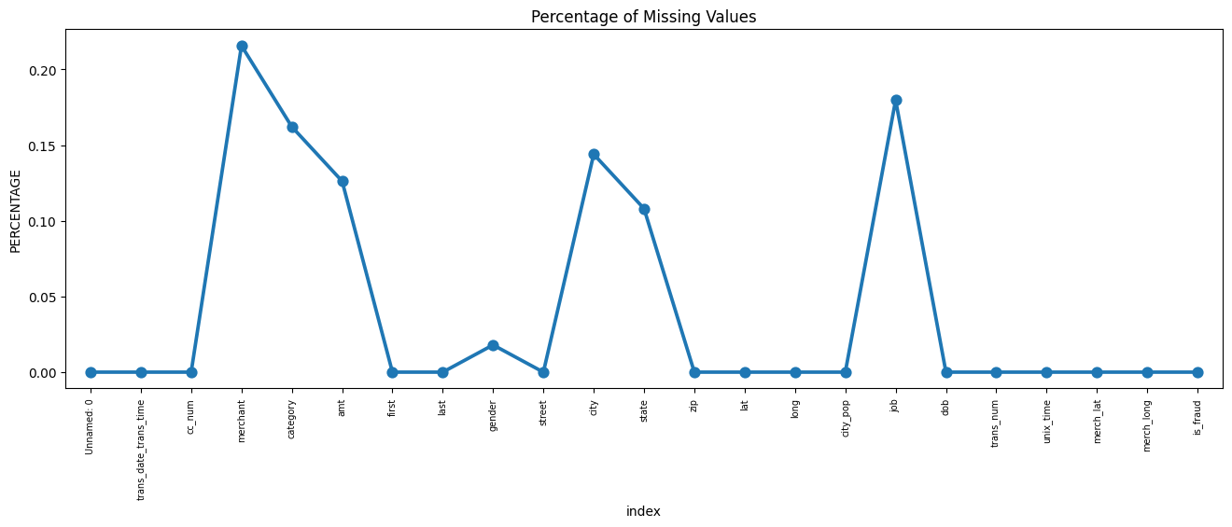
Initial Intuition from the data
Findings
Nearly Perfect Data Quality: Almost
every column is completely full. The
missing values are so tiny (less than 0.25% in any column) that almost no data need to be
thrown away.
Key Information is 100% Present: Essential columns like fraud labels (is_fraud) transaction amount, dates, and locations have zero missing values.
Only a Few Columns need Cleaning: Missing value only show up in a handful of field – mostly merchant names, job titles, spending categories, and cities.
Quick and Easy Fixes: Because so little is missing, filling in the gaps (like looking up missing cities using zip codes or filling empty amount) can be done quickly without messing up the dataset.

Slide 7
Categorical Analysis

Slide 8
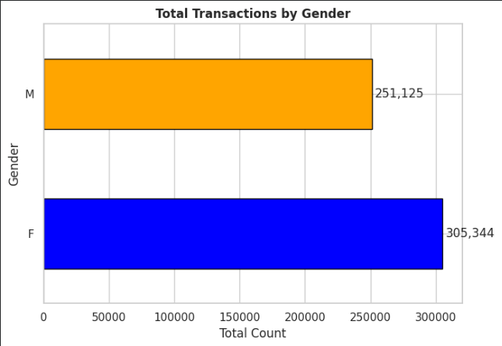
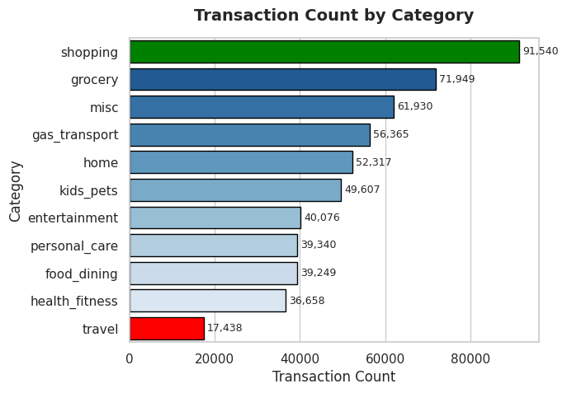
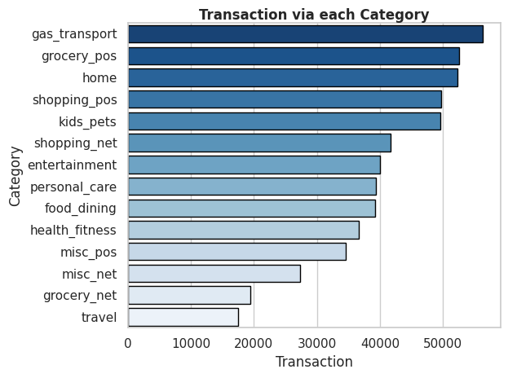
Univariate
Analysis
Findings:
As per gender, female are using credit card more than male. Most probably, females are the more likely to be fraud. As per categories, gas transport has more transactions but if we combine shopping pos & shopping net, then it is high. There might be more frauds in shopping or gas transport. We will deep dive into it in further slides…..

Slide 9
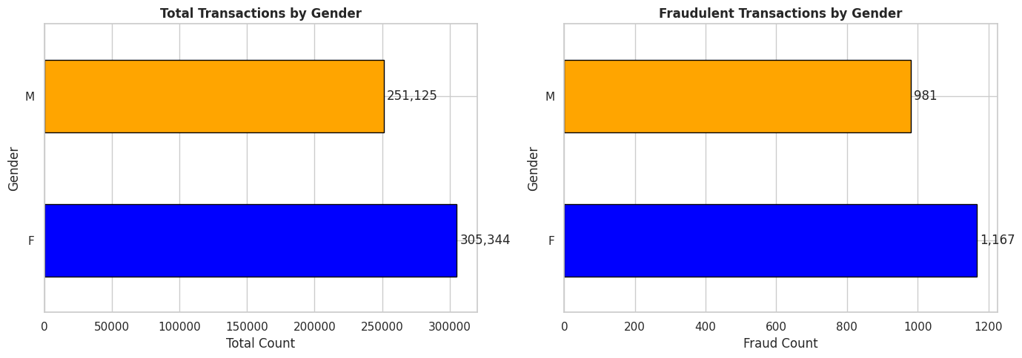
Gender v/s Target Variable
Findings:
As per the data, female are doing almost 3.05 lakhs transactions. In those transaction, there are 0.38% frauds.
As per male category, it is almost same 0.39% frauds.
In the conclusion, both are the part of fraudulent category.

Slide 10
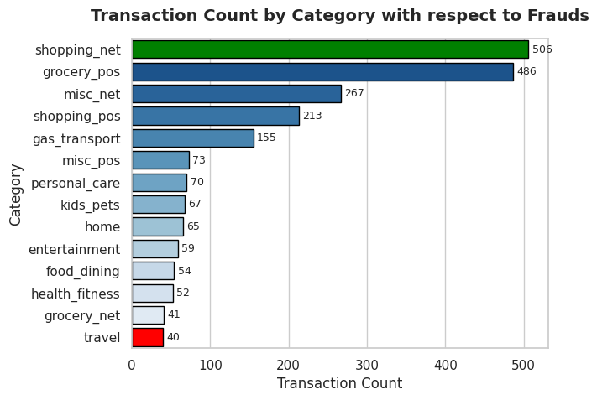
Category v/s Target Variable
Findings:
As per the data, we can easily analyze and say shopping_net has more fraudulent transactions. It mean people who are doing online shopping, are more likely to be fraud.
As per the data shopping_net has 1.2% fraud rate and gas_transport has only 0.2% fraud rate.
We have noticed one thing also, grocery_pos has 486 fraudulent transactions out of 52000 transactions 0.93% fraud rate.
If we analyze the misc_net, then we find that it has also the same 0.95% fraud rate.
In conclusion, people who are doing online shopping, are more likely to be fraud credit card users.

Slide 11
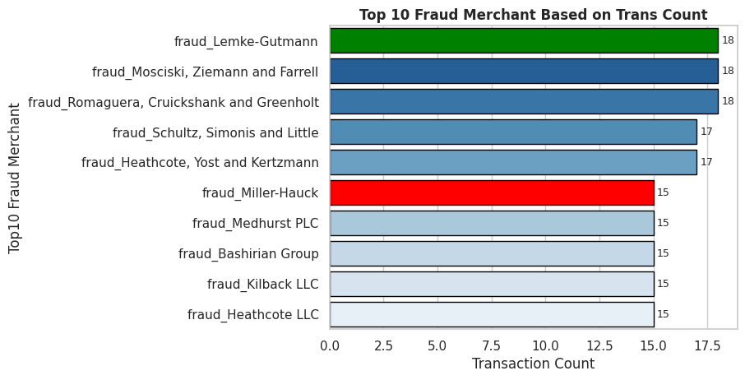
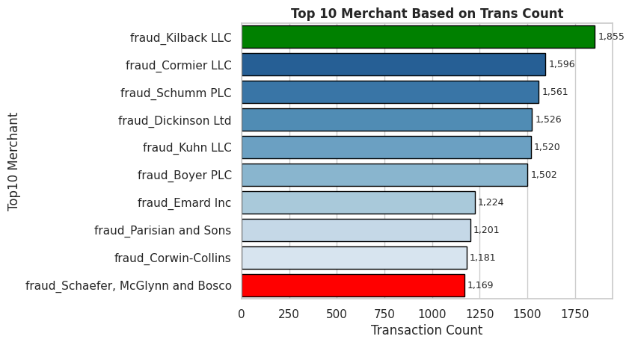
Top 10 Merchants & Top 10 Fraud Merchants
based on the transaction count
Findings:
As per the given data, there are top 10 merchants who have most transaction counts and top 10 fraud merchants who have most transaction counts. There is one merchant fraud_Killback LLC has 15 fraud trans counts out of 1855 trans counts.
fraud_Killback LLC has 0.8% fraud rate.
In conclusion, we need to keep an eye on each top 10 fraud merchants because it has less than 1169 trans counts and has more than 0.8% fraud rate.

Slide 12
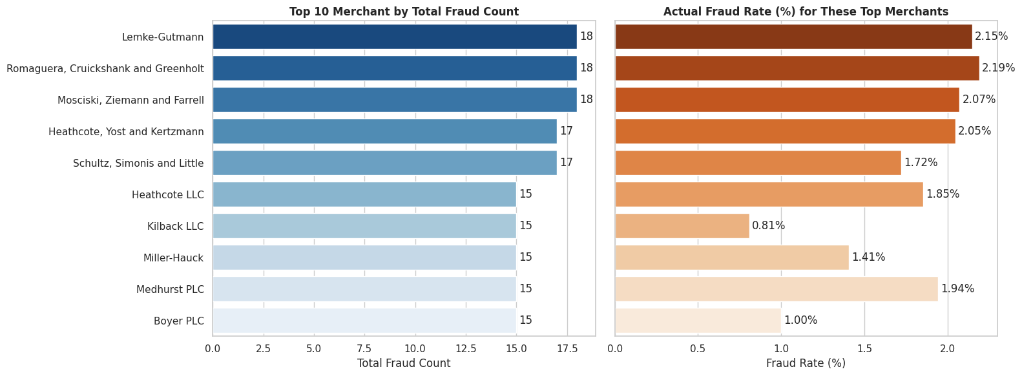
Top 10 Fraud Merchants Fraud Rate Analysis
Findings:
As we thought, here is top 10 fraud merchants and each one has more than 0.8% fraud rate.
Romaguera, Cruickshank and Greenholt Merchant has high fraud rate 2.19% and same goes to Lemke Gutmann Merchant.
In conclusion, we need to keep an eye on these merchants in fraud detections.

Slide 13
Numerical Analysis

Slide 14
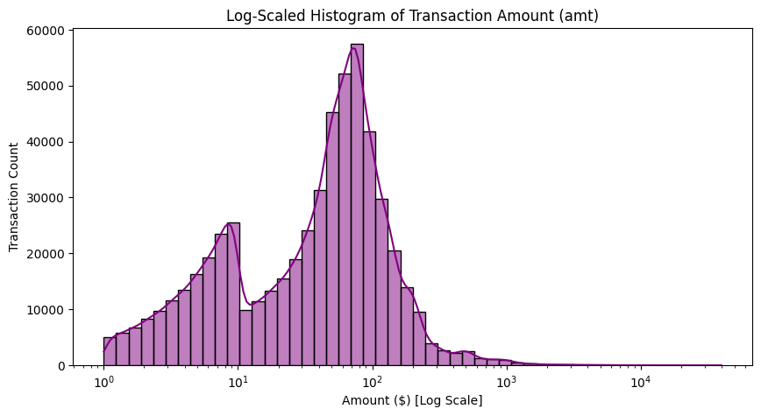
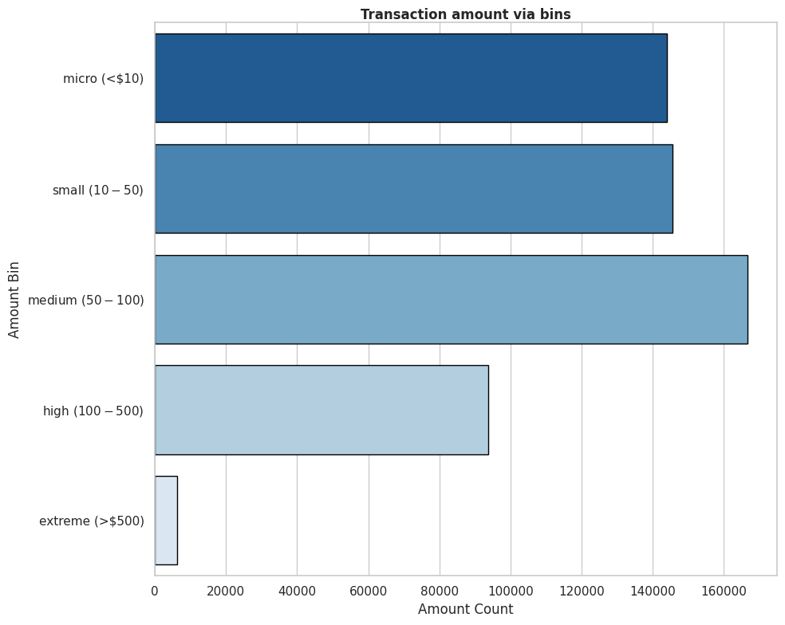
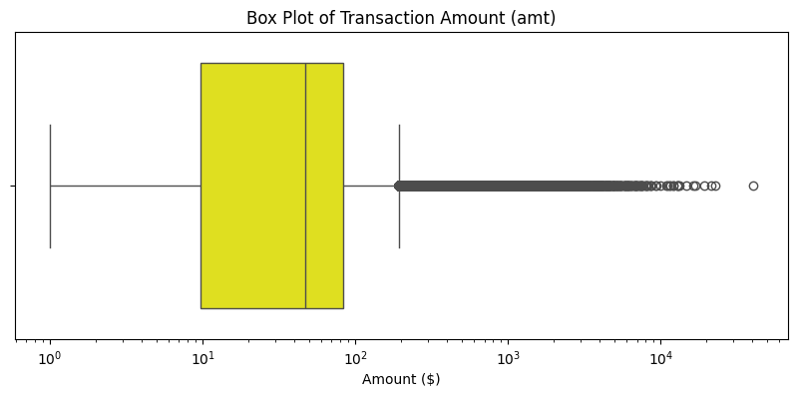
Univariate
Analysis
Findings:
As per the data, amount is significantly high. Most of the people spend less then 500$. Here, we have higher outliers but we need to keep it because there are high chances to be frauds. We will deep dive into it………

Slide 15
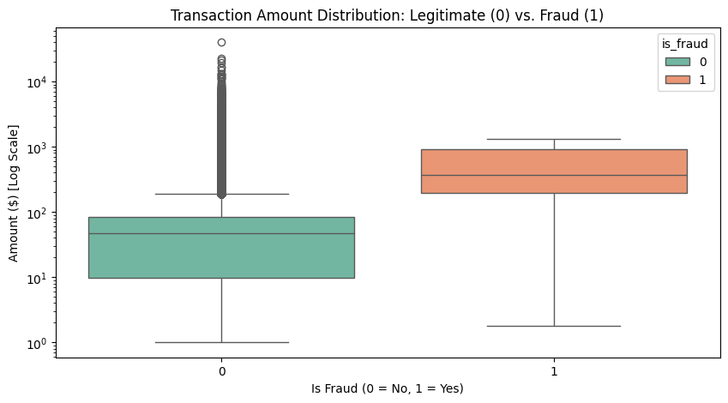
Amount v/s Target Variable
Findings:
In the box plot, it is clearly visible that those are the outliers, have significantly higher frauds.
We have noticed that most of the frauds are lie between 500$ and 1000$.
We need to analyze more to get a perfect insight to check whether it can be helpful or not.

Slide 16
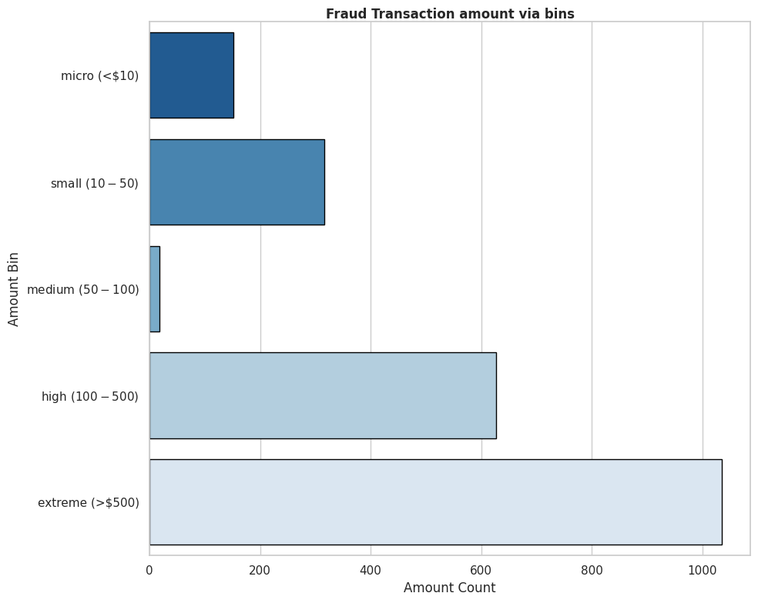
Fraud Transaction Amount via Bins
Findings:
As per the data, we can clearly see that extreme (>500$) has more fraud rates.
Other bins like micro, small, medium and high has also fraud rates but extreme has significantly high fraud rate.
We will more analyse it to get the insights from it. Let’s deep dive on it……..

Slide 17
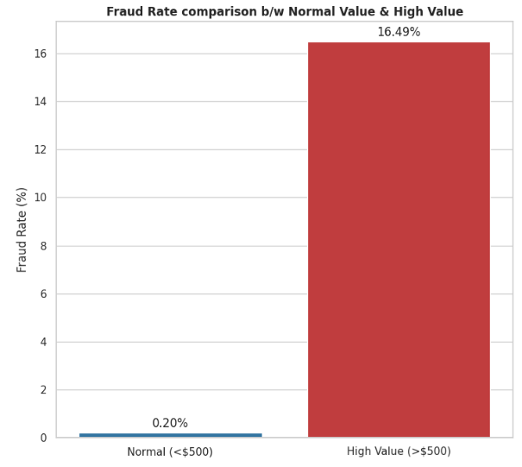
High Value Fraud Rate v/s Normal Fraud Rate
Findings:
After looking at this data, first we need to understand that the amount which is higher than 500$, is really important.
It is clearly visible that those people who are paying less than 500$ are more legitimate. Just 0.2% fraud rates are there.
Those people who are paying more than 500$ via credit card, is more likely to be frauds. Fraud rate is 16.49% there.
From now we will understand one by one feature with high value to analyze the data more clearly.
Let’s check further……….

Slide 18
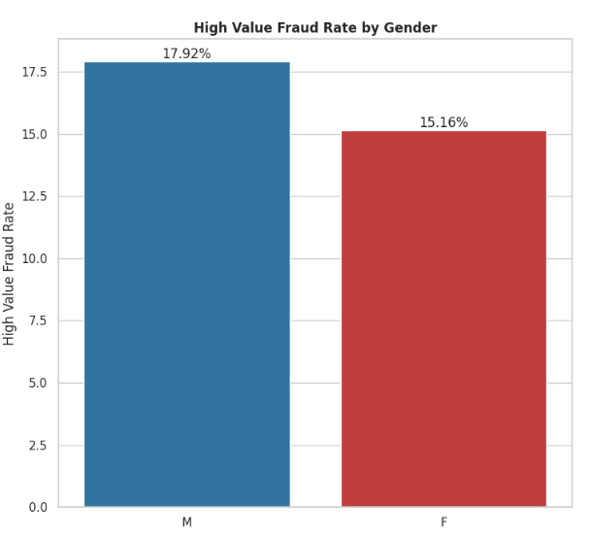
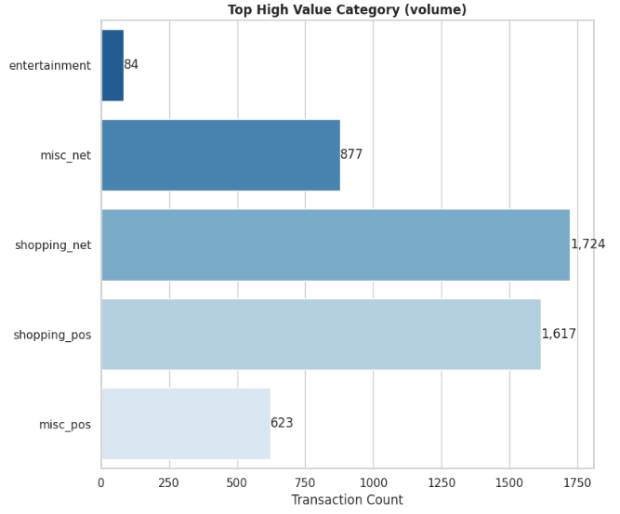
High Value Category & Gender
Findings:
As per the data, male category has high in extreme bin which tells clearly that male is more likely to be frauds.
As per the category feature, shopping_net has more trans counts (high value).
In conclusion, male and shopping_net both contains more fraudulent accounts.

Slide 19
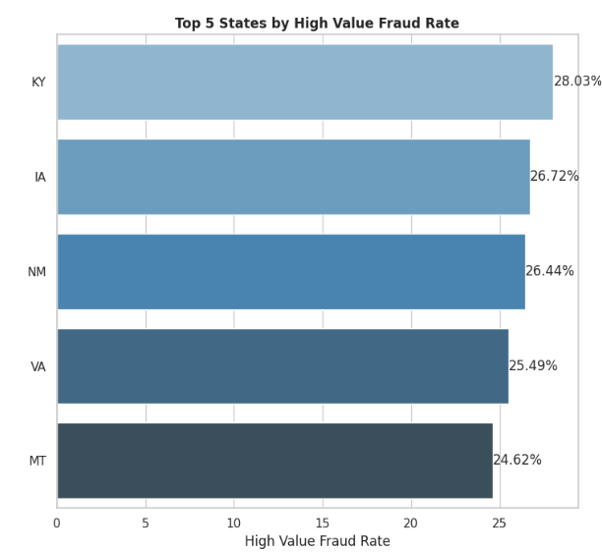
Top 5 States by High Value Fraud Rate
Findings:
As per location, we have noticed that there are top five states with high value, which has more than 24.5% fraud rates.
As per these fraud rates, it is easily understandable that we need to monitor these state definitely in fraud detection.
KY, IA, NM, VA and MT are the most fraudulent account states.

Slide 20
Time Series Analysis

Slide 21
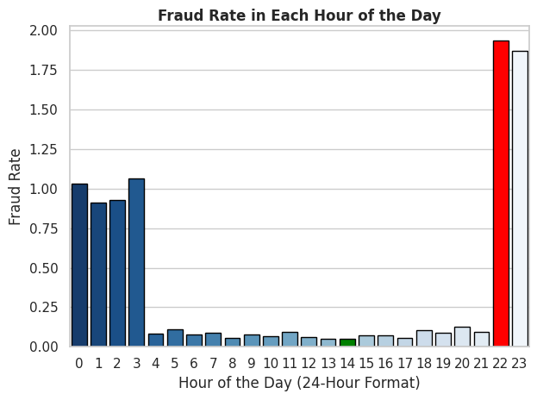
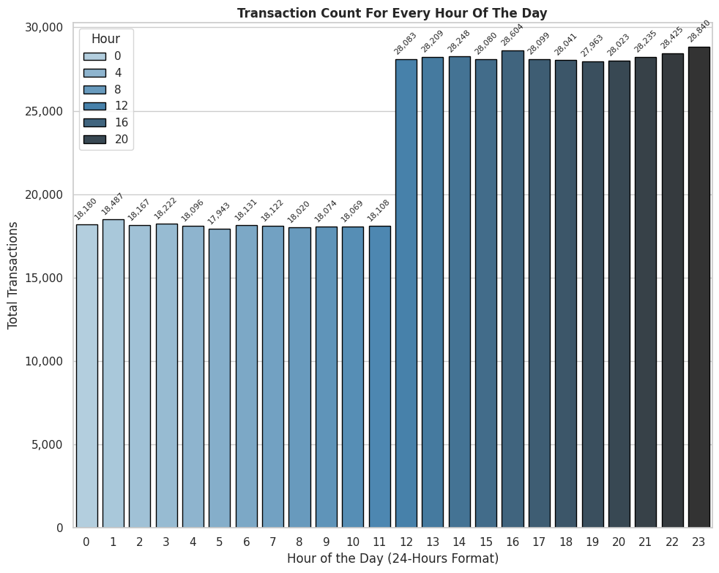
Transaction count and Fraud Rate in Each Hour of the Day
Findings:
When we see the transaction count via each hour of the day, we find very interesting thing.
As per the data we can clearly see that b/w 10PM & 11PM each day, there are many frauds (1.95% fraud rate) .

Slide 22
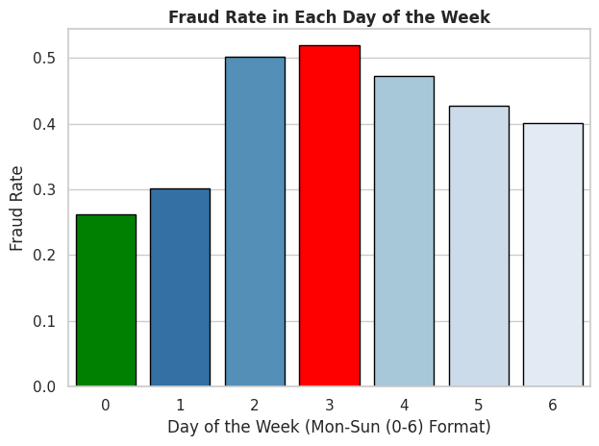
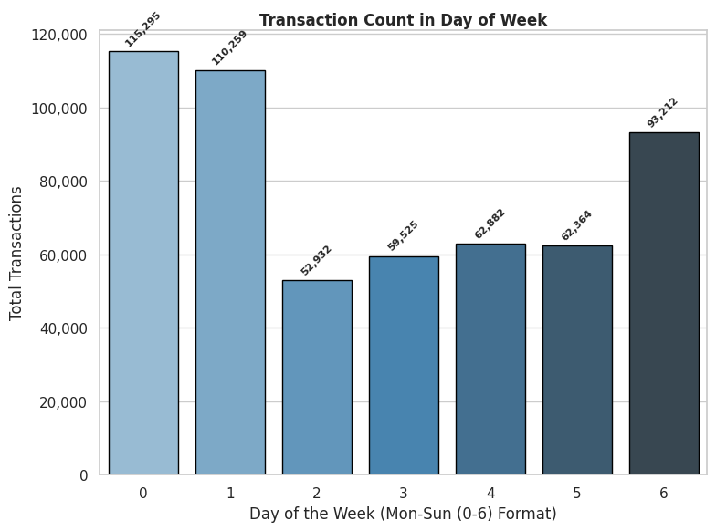
Transaction count and Fraud Rate in Day of the Week
Findings:
As per the data, there is no any significant difference but we can see there are around 0.5% fraud rate in Wednesday & Thursday.

Slide 23
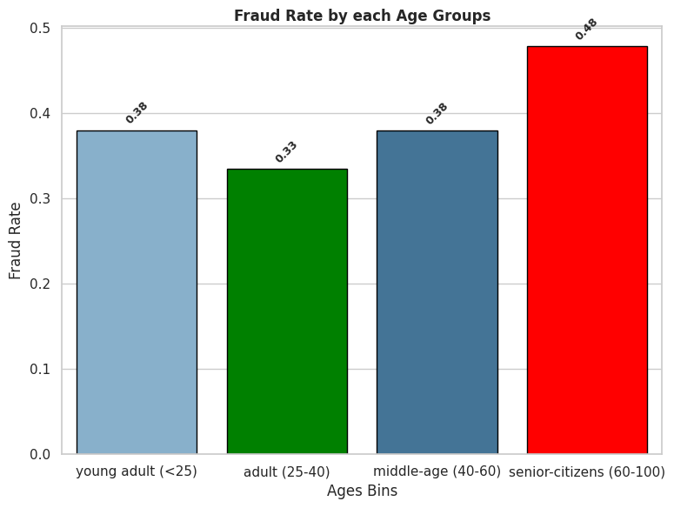
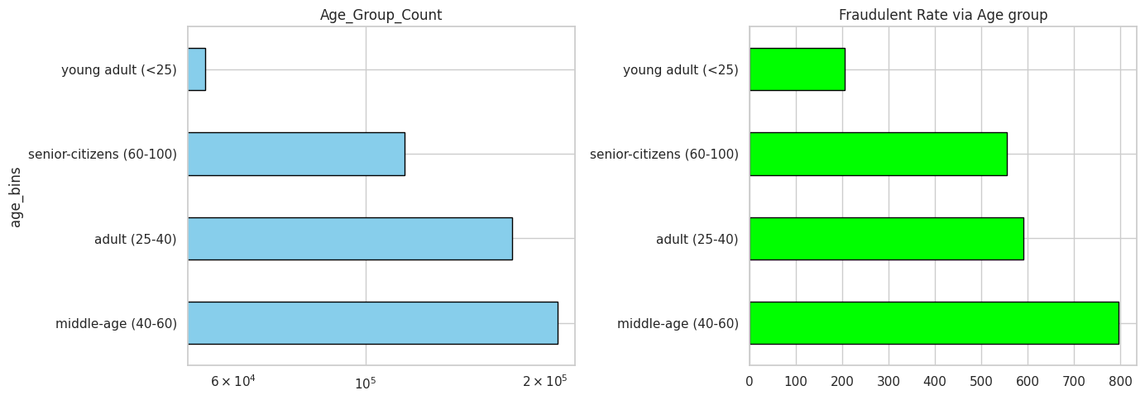
Age Group v/s Target Variable
Findings:
As per the data, those who are middle-age (40-60), are more using credit cards.
When we see with target variable, we can clearly see that there is no any significant difference.
Fraud rates are between 0.38% and 0.48%.
In conclusion, we will have to analyze each age group in fraud detection.

Slide 24
Thank you
Kalpit Kishore

